Slide 1
Jira
CSC 4160
By Talia Vivrett

Slide 2
AGENDA
Background/History
1
Benefits
2
Components Explained
3
Summary
4

Slide 3




- An agile product management tool
- Used for both scrum and kanban methodologies
- Created by Atlassian in 2002
- Originally created as a bug and issue tracking tool for software developers
- Today it is mainly used by software teams to plan, track, and manage work
- Also used to organize deployments and production timing
Background

Slide 4
Agile PM
Tracking
Analytics
Integration
Benefits
Scrum + kanban
Board management
Sprint planning
Backlogs
Bugs & issues
Allows prioritization
Task creation
Burndown charts for each sprint
Velocity charts
Status tracking
Github
Slack
Confluence
Etc.

Slide 5
Components explained
Issues
A unit of work in Jira
Could be tasks, stories, spikes, bugs, epics
Fields:
  Effort points
  Priority
  Assignee
  Created by
  Due date
  Status
  Description

Slide 6
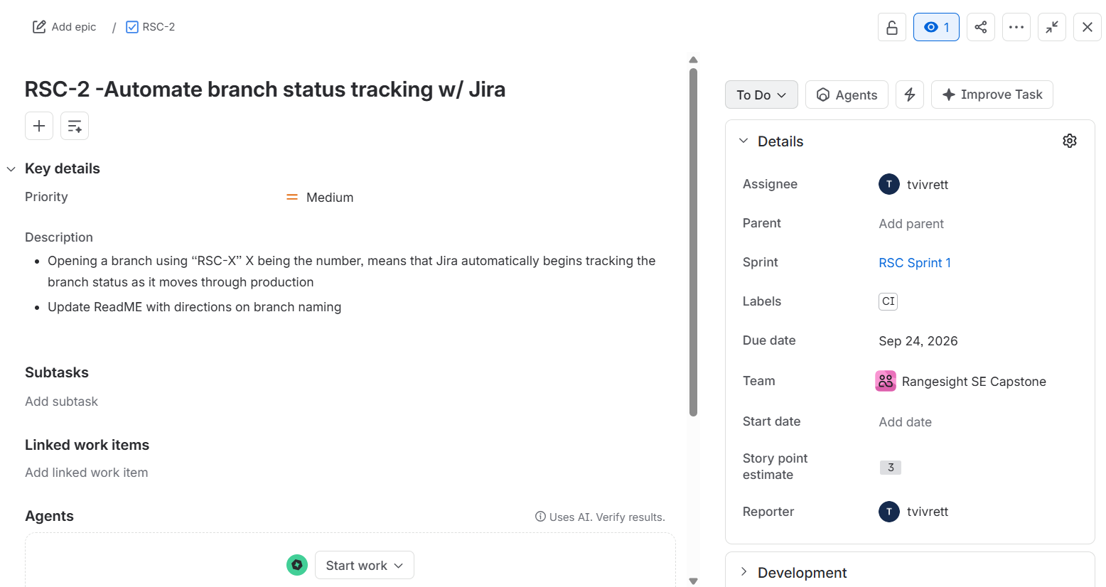
Issue ex:

Slide 7
Components explained
Boards
Scrum board
work organized into sprints
backlog + sprint planning
Kanban board
continuous flow
work moves through status columns
Common columns:
To Do
In Progress
Code review
Done

Slide 8
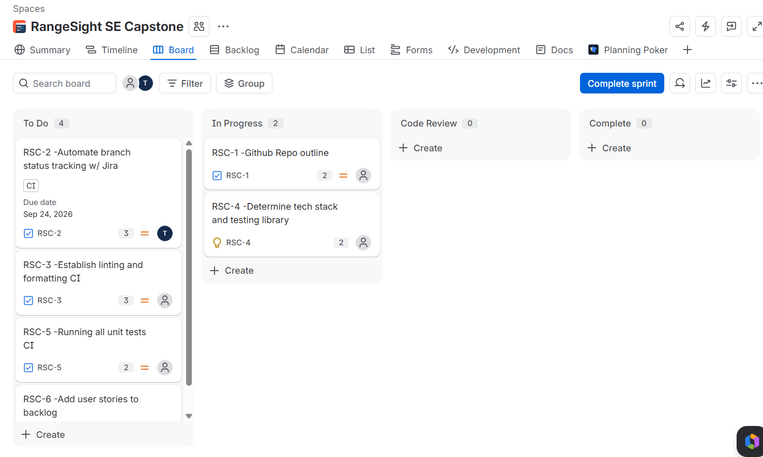
Board ex:

Slide 9
Components explained
Backlogs, sprints, epics
Backlog: prioritized list of future work
Epic: large feature or goal containing multiple issues
Sprint: fixed period of time where a team completes selected work
Teams pull issues from the backlog into a sprint
Epic
Stories
Subtasks (if applicable)
(organized into sprints)

Slide 10
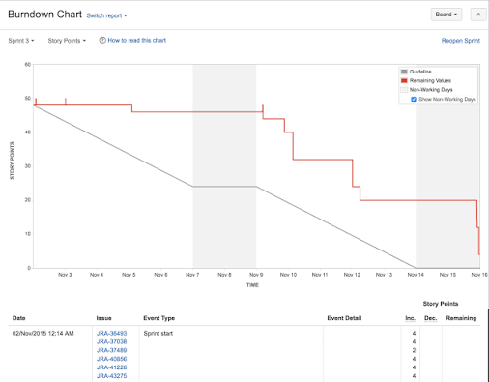
Components explained
Reports/Analytics
Burndown charts: tracks remaining sprint work over time
Velocity chart: tracks work completed each sprint
Helps determine future workload + highlight any forgotten work

Slide 11
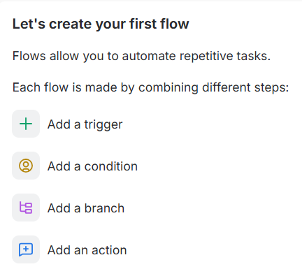
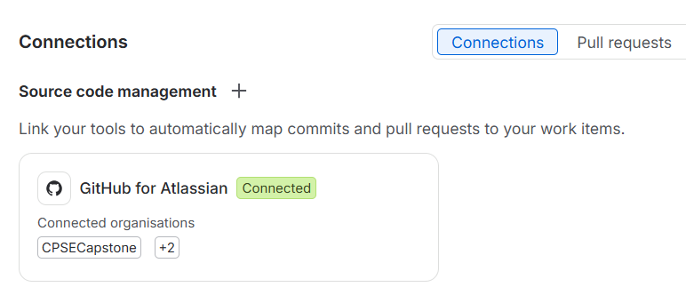
Components explained
Automations & Integrations
Automate workflows
Link Github branches
Connect slack channels

Slide 12
Background
Benefits
Components
Summary
Originally built by Atlassian as a software tool for bug tracking
Helps plan, organize, and track software development work
Issues, boards, sprints, workflows, reports
Main takeaway: A useful tool for assigning, organizing, monitoring, and planning work

Slide 13
References
https://calpoly-se-capstone.atlassian.net/jira/software/projects/RSC/development?severity=CRITICAL%2CHIGH&sortKey=updated&sortOrder=DESC&tab=CONNECTIONS
https://ardura.consulting/glossary/jira/
https://www.atlassian.com/software/jira/features

Slide 14
Thank you! Questions?

